Slide 1
GLTF & Surface materials
3DCC day5

Slide 2
GLTF 3D Model Format deep dive
File structure, variations, vertex/index formats, Materials, 3DCC exporter, advanced

Slide 3
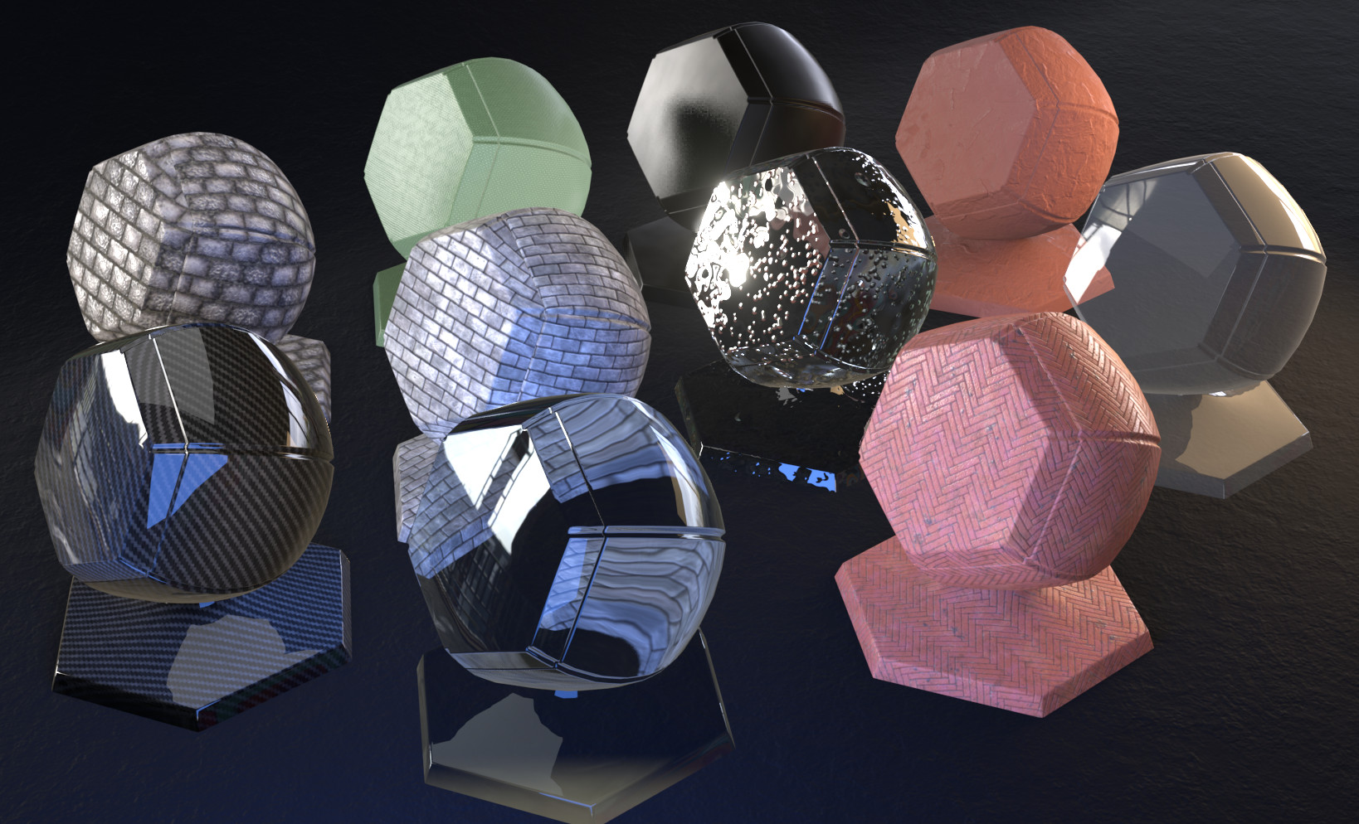
SURFACE materials

Slide 4
CLASSIC MATERIALS
Designed to tune/tweak the classic shading formulas we discussed earlier.
Examples: Specular Exponent & Intensity, Diffuse, Ambient, Specular and Emissive Color.
Unlike modern materials, these need to be hand tweaked by artists depending on a given lighting environment to look physically correct.
The major benefit is that these algorithms are easy to understand and very cheap to run on pretty much any 3D hardware. (low power mobile devices included)
Most games have moved to PBR based materials and workflows, but classic shading algorithms may still be relevant when performance is limited or PBR is overkill for a particular visual style.

Slide 5
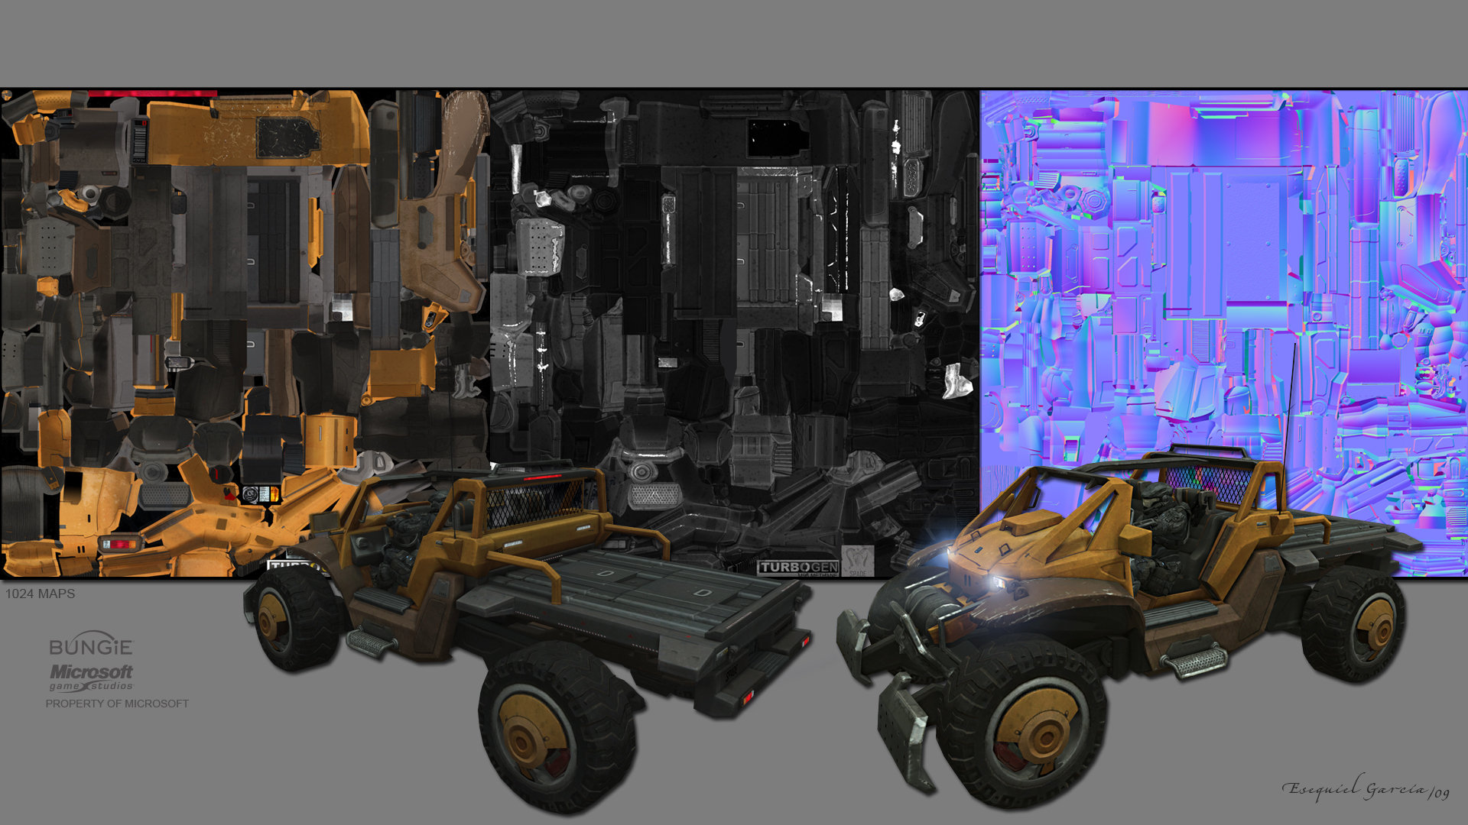
USING CLASSIC MATERIALS
A model file will contain a list of materials attributes to be used by each sub-mesh of the model.
Though art programs support multiple illumination models, games typically just use one. (some attributes are ignored)
Most non-PBR game-ready models will also come with diffuse, normal & specular/reflection textures as well.
We use these in the pixel shader to further tune the lighting for each pixel.

Slide 6
MODERN MATERIALS (PBR)
Uses significantly more physically accurate mathematics. Focuses on energy conservation, image based lighting and accurate Fresnel edge reflections.
Direct light shapes are the same as classic, but environment light & reflections are often read from a specially prepared cube map with light energy encoded. (optional)
Because the formulas are better at mimicking actual light behavior on surfaces, little to no hand tuning is required. (Artists instead describe the physical properties of surfaces)
A PBR shader is significantly more theoretically complex and expensive to run than a classic shader, however the visual improvement is significant.
Most PBR data comes in the form of textures not model file attributes. (per-pixel materials)

Slide 7
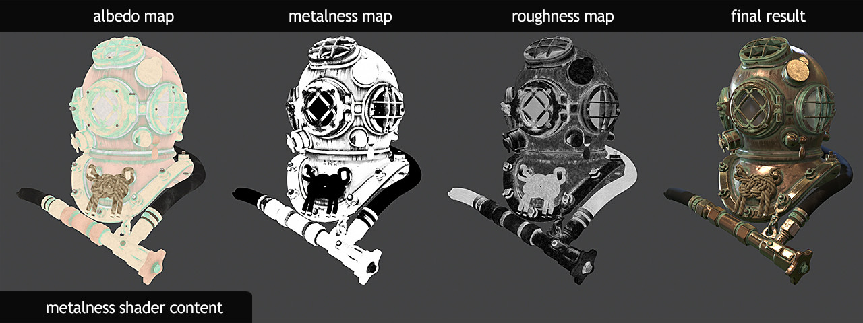
USING Modern MATERIALS
Materials overall are simpler:
Albedo HDR, Roughness 0-1, Metallic T/F
Typically, these materials need only be provided in texture form since no hand tuning is required.
Most PBR game-ready models will have a normal map and a combination of texture data to represent the 3 attributes.
We use these 3 attributes (along with an environment lighting map) in the pixel shader as arguments to the PBR formulas.

Slide 8
Game Rendering: Tools and resources
Model loading
Texture loading
PBR workflow
TinyGLTF
Open Asset Import Library
PVRTexTool
KTX Texture Library
PBR Example Shaders
Materialize

Slide 9
Programming presentation
Using CMAKE to LINK the tiny gltf library + loading CPU model data

Slide 10
Q

